Slide 1
Machine Learning
Model Construction

Slide 2

Previous Day Recap
Duration - 2 minutes.
Interactive Discussion

Slide 3
Module Objectives
After completing this course you will be able to:
Understand how data is used in model construction
Explain what is the purpose of testing
Describe what is cross validation and why it matters
List the different classes of machine learning models
Describe what sensitivity analysis does

Slide 4



Learning From Data
To recap: ML models are shaped by data, similarly to how our brains are:
Data IN
Insight OUT
We take data in
We compare it with previous examples
We make decisions (… sometimes we guess)
We derive insights that will inform future decisions

Slide 5
Learning From Data
But … how?! How can we use old examples to make new decisions?
In other words: how do we write a machine learning algorithm?

Slide 6
Learning From Data
But … how?! How can we use old examples to make new decisions?
In other words: how do we write a machine learning algorithm?
Actually, we don’t!
A wide variety of algorithms are already available
We just need to choose one …
… and maybe fine-tune it a bit

Slide 7
Model Fitting
Fine-tuning and configuring an algorithm is not done randomly:
It may partly depend on the developer’s experience
But, mostly, a model’s parameters are made to fit some set of training data
This is what we mean when we say that the model is shaped by data
This process is called model training, or model fitting
The training dataset consists of pairs of an input vector and some output value
The resulting model will be an approximation of the underlying function
Overfitting happens if the model approximates the training data too closely
If it identifies relationships in the data that do not hold in general

Slide 8
Model Testing
To prevent overfitting, the model needs to be tested:
A new set of data, called the testing set, is required
The model’s predictions are compared against the expected values
This allows to assess the model’s performance on brand new data
Both the training and testing sets should be chosen carefully:
Selection bias should be avoided
Aim for sets that follow the distribution of the overall population
The training set may consist of 80% of all the input data
The remaining 20% would then be used for testing
Often multiple models are trained and tested, not just one
The best performer is then selected

Slide 9
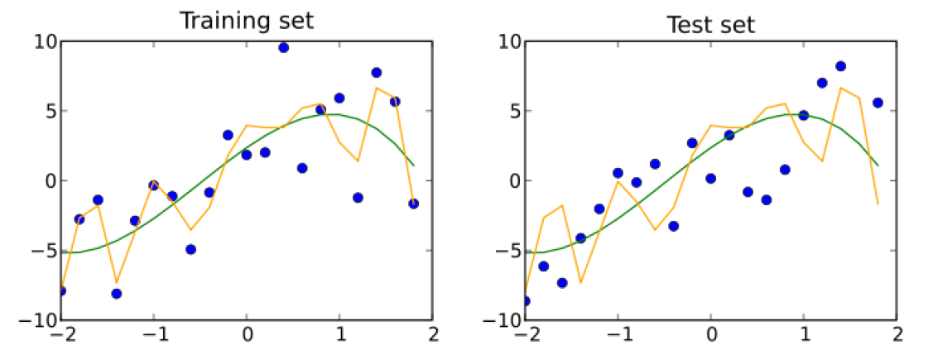
Overfitting By Example
Two distinct models obtained from the same training data:
The yellow model is overly fit to the training data
The green model offers a good approximation

Slide 10

Training and Testing … in the brain
Our thought process offers yet another analogy for training / testing:
We don’t know exactly how decisions are made
That’s our unconscious brain at work
It takes data in as sensory signals (our training set)
It produces thoughts (that inner voice you hear all the time)
Not all thoughts are converted into actions
The conscious brain then assesses each possible decision
Like a data scientist who compares the outcomes of different models
The assessment is based on experience (our testing set)
Only the thoughts that make more sense are converted into actions
Those represent our best models so far!
Notes:
***** DISCLAIMER ***** : The above is a very simplistic view of our brains, and is only useful as an interesting analogy that offers a different perspective on the whole machine learning process.
This said, the analogy can be pushed a little further…
Note, for example, that the training set for the unconscious brain likely consists of some view on the history (i.e., a partial history) of all sensory signals ever received; while the testing set is yet a different view.
One could also argue that the history of all the sensory signals we’ve ever received (and the chain of thoughts that they started) is who we are : They make us, just like the training and testing datasets make a model. Our personality is the result of our history and our genes. Analogously, a machine learning model is the output of the training and testing phases. It therefore depends heavily on the datasets used in each phase, as well as on some other preliminary assumptions, such as the choice of the algorithm and the values of the parameters used for its initial configuration.

Slide 11
Model Validation
When do we stop training?
Use yet another input set to assess a model’s performance as it is trained:
A decline in performance could be a sign of overfitting
Early stopping technique: stop training as soon as performance declines
More advanced techniques are available to avoid getting stuck in local optima
This assessment is called validation; the used set is the validation set
What’s the difference between validation and testing?
Validation is used to decide when the training process should stop
Testing is used to compare the performance of a model versus others
The model is validated as it is trained…
… but it is only tested at the end
Notes:
Note that, since validation is performed while training is still ongoing, the validation set may affect the model. Testing, on the other end, is only performed at the very end, when all of the model’s parameters are finalized. Then the testing set does not affect the model in any way. This is why the testing set is also called holdout set.

Slide 12
Cross-Validation
A model may still be fitting the particular training and validation sets too closely
In comes cross-validation to the rescue!
Multiple rounds of training and testing are applied
In each round, a different partition of the input data is chosen
The validation results are combined to get a better measure of fitness
Exhaustive cross-validation methods try all possible training/validation data partitions
Examples: Leave-p-Out CV, Leave-One-Out CV
Highly reliable results, but very inefficient implementation
Non-exhaustive methods offer a more practical approximation:
Examples: K-fold CV, Monte Carlo CV
Notes:
Some links on cross-validation:
https://stats.stackexchange.com/questions/52274/how-to-choose-a-predictive-model-after-k-fold-cross-validation
https://scikit-learn.org/stable/modules/cross_validation.html#cross-validation

Slide 13
Exercise 1
Research and compare different kinds of cross-validation
Duration - 15 minutes.
Discussion & Feedback.

Slide 14
Model Classification
We have talked about how algorithms can be trained and tested with data to produce a model
It is now time to look into the algorithms themselves!
Machine learning algorithms can be split into two broad classes:
Supervised learning
Both inputs and outputs are provided
Unsupervised learning
Only inputs are available (no outputs or labels)
Other classes may also be defined:
Semi-supervised learning (output only available for some input)
Reinforcement learning (results are fed back to the model)

Slide 15
Supervised Learning Models
Supervised learning
Takes data structured as input / output pairs
Looks for a function that maps inputs to outputs
Requires prior training and testing of the model
Supervised models can be further divided into two subclasses:
Regression models
Predict continuous output values:
Temperature; currency value; probability of fraudulent activity
Classification models
Predict which class a certain input belongs to:
Two-class output (low risk / high risk; spam / not spam, …)
Multi-class output (“horse”, “dog”, “cat”, …)

Slide 16
Unsupervised Learning Models
Unsupervised learning
Tries to infer structure from the data
Does not require prior training and testing of the model
May be applied to simplify / enhance input data to be used in further analysis, e.g.:
Algorithms for data cleaning, data / feature selection, feature extraction, …
Two main subclasses of unsupervised models:
Cluster Analysis
Split input data into subclasses that share common features
Classes are typically hard to categorize manually
Anomaly detection
Spot anomalous entries (outliers) in the input:
Excessively high withdrawal amount, …

Slide 17
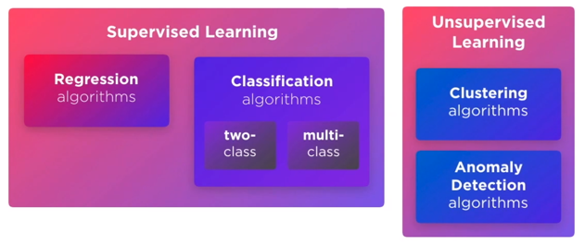
Model Classification: The Full Picture

Slide 18
Sensitivity Analysis
Understanding the model is crucial to:
Validate its correctness
Detect bias or leakages
Learn new patterns in the data
Every model relies on assumptions
Assumptions are necessary for the model to work …
… but they make a model's interpretability a complex task
Sensitivity analysis is a technique used in forecasting to understand:
what assumptions a model relies on
how a small change in one assumption can affect the model

Slide 19
Sensitivity Analysis
Sensitivity analysis tries to answer the following questions:
How reliable are the assumptions made?
What happens if assumptions turn out to be very different?
What assumptions are most significant to the analysis
Each feature i is examined independently:
Feature i is changed while other features are kept constant
The change in performance gives the sensitivity for feature i
Notes:
Note that there are methods for feature importance such as correlation feature selection and mutual information that use a mathematical calculation to get the importance of a feature. Those methods can be used to select features before running the model but they don’t use the model itself in their calculation. Other methods to calculate feature importance are applicable for a specific estimator, such as Random Forest Feature Importance. Those methods can’t necessarily be used for black box models.

Slide 20
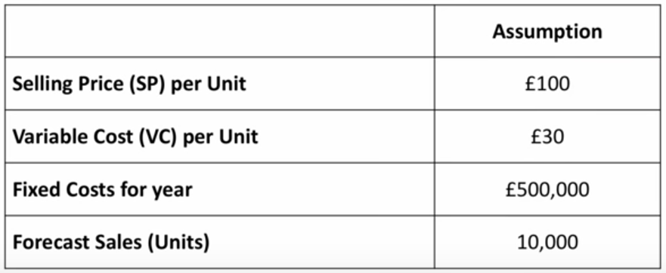
Sensitivity Analysis: Example
Suppose we want to forecast the profit for our business based on the following assumptions:

Slide 21
Sensitivity Analysis: Example
The profit can be calculated using the following formula:
profit = revenue – variable cost – fixed costs
Given that:
revenue = spu * units = 100 * 10,000 = 1,000,000
variable cost = vcu * units = 30 * 10,000 = 300,000
We have:
profit = 1,000,000 – 300,000 – 500,000 = 200,000

Slide 22
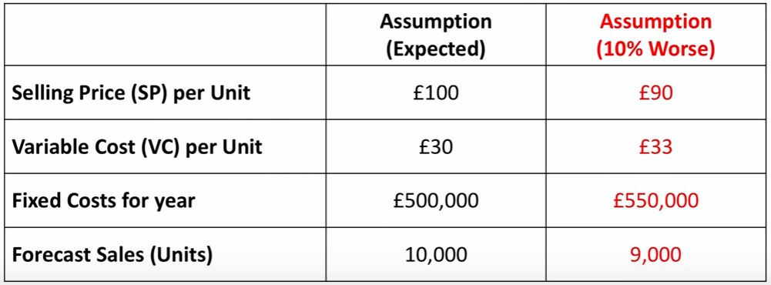
Sensitivity Analysis: Example
What if we (independently) make each assumption worse by 10%?

Slide 23
Sensitivity Analysis: Example
What if we make selling price per unit worse by 10%?
Here is how revenue would change:
revenue = spu * units = 90 * 10,000 = £900,000
Everything else would stay the same
Then, here is how profit would change:
profit = 900,000 – 300,000 – 500,000 = £100,000
This constitutes a 50% decrease from the original estimate of £200,000

Slide 24
Sensitivity Analysis: Example
What if we make variable cost per unit worse by 10%?
Here is how variable cost would change:
variable cost = vcu * units = 33 * 10,000 = £330,000
Everything else would stay the same
Then, here is how profit would change:
profit = 1,000,000 – 330,000 – 500,000 = £170,000
This constitutes a 15% decrease from the original estimate of £200,000

Slide 25
Sensitivity Analysis: Example
What if we make fixed costs worse by 10%?
Here is how fixed costs would change:
fixed costs = £550,000
Everything else would stay the same
Then, here is how profit would change:
profit = 1,000,000 – 300,000 – 550,000 = £150,000
This constitutes a 25% decrease from the original estimate of £200,000

Slide 26
Sensitivity Analysis: Example
What if we make forecast sales worse by 10%?
Here is how revenue and variable cost would change:
revenue = spu * units = 100 * 9,000 = 900,000
variable cost = vcu * units = 30 * 9,000 = £270,000
Fixed costs would stay the same
Then, here is how profit would change:
profit = 900,000 – 270,000 – 500,000 = £130,000
This constitutes a 35% decrease from the original estimate of £200,000

Slide 27
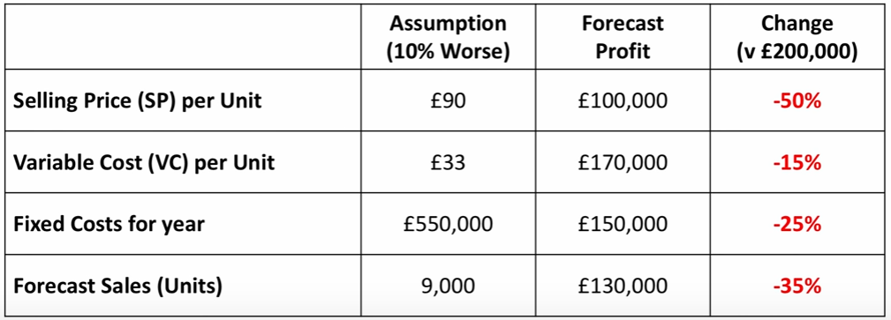
Sensitivity Analysis: Example
To recap:
We conclude that selling price per unit is the most sensitive feature

Slide 28
Module Review
How is data in ML used differently than in other applications?
What is the purpose of having separate sets for training, validation and testing?
What is the purpose of the cross-validation phase?
How can we classify ML models?
How can assumptions be tested?

Slide 29
Module Outcomes
You should be able to:
Understand how data is used in model construction
Compare validation and testing and tell why they are both important
Explain what cross-validation accomplishes
Classify ML models
Explain how sensitivity analysis is used to test assumptions

Slide 30
Questions

